Slide 1
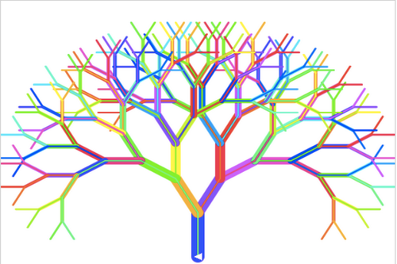
Dec
Lecture 12 - Decision Trees – Part 2
Hamed Hasheminia

Slide 2
Agenda
Bagging
Random Forest
Boosting

Slide 3
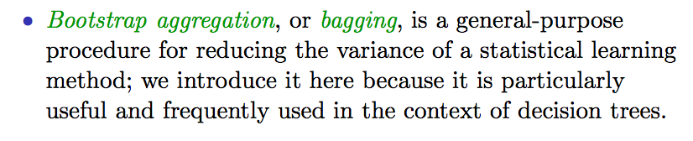
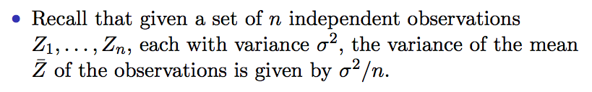
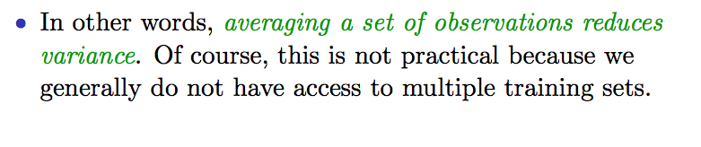
Bagging

Slide 4
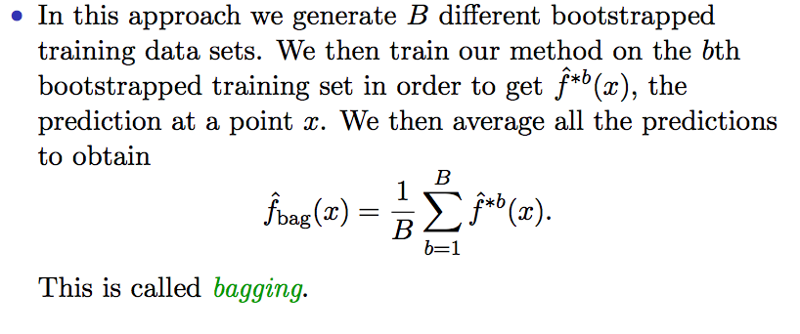
Bagging
Notes:
So the prediction will have a smaller variance because of multiple sample sizes

Slide 5
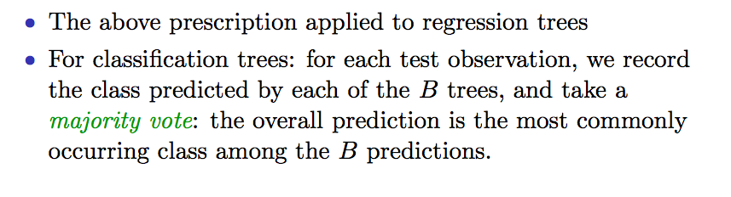
Bagging

Slide 6

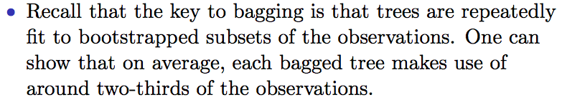
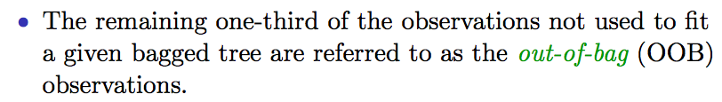
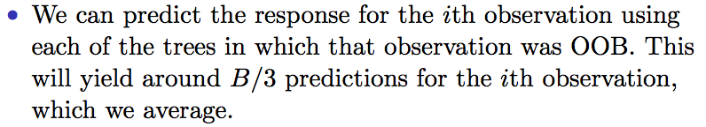
Out-of-Bag Error Estimation

Slide 7
Random Forest
Random Forests provide an improvement over bagged trees by way of a small tweak that decorrelates the trees. This reduces the variance when we average the trees.
As in bagging, we build a number of decision trees on bootstrapped training samples.
But when building these decision trees, each time a split in a tree is considered, a random selection of m predictors is chosen as split candidates from the full set of p predictors. The split is allowed to use only one of those m predictors.
A fresh selection of m predictors is taken at each split. Typically we choose m = sqrt(p) for classification and m = p/3 for regression.

Slide 8
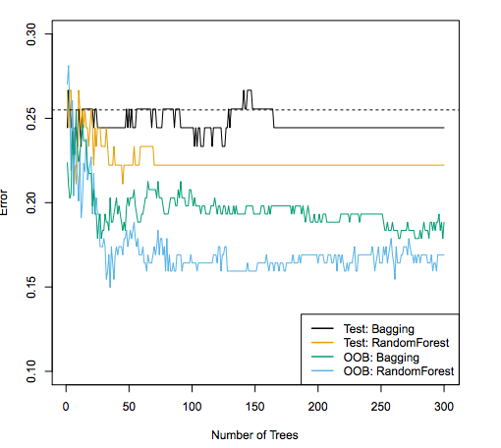
Bagging vs Random Forest in Heart Data

Slide 9
Boosting
Like bagging, boosting is a general approach that can be applied to many statistical learning methods for regression or classification. We only discuss boosting for decision trees.
Recall that bagging involves creating multiple copies of the original training data set using the bootstrap, fitting a separate decision tree to each copy, and then combining all of the trees in order to create a single predictive model.
Notably, each tree is built on a bootstrap data set, independent of the other trees.
Boosting works in a similar way, except that the trees are grown sequentially: each tree is grown using information from previously grown trees.

Slide 10
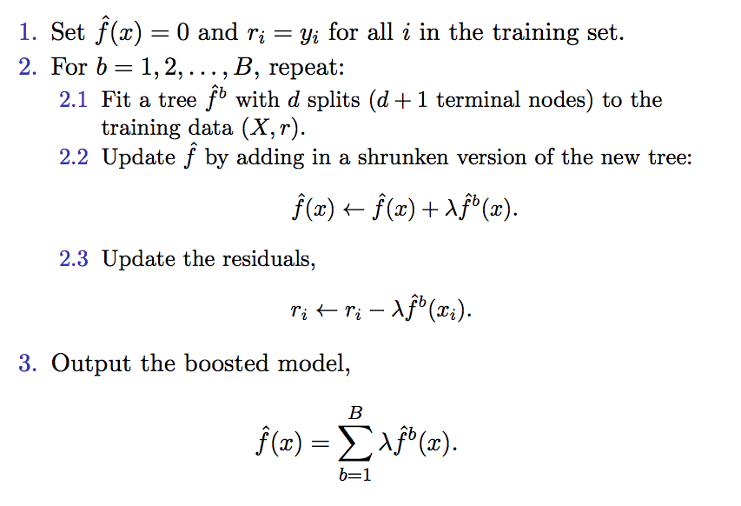
Boosting algorithm for regression trees

Slide 11
What is the idea behind this procedure?
Unlike fitting a single large decision tree to the data, which amounts to fitting the data hard and potentially over-fitting, the boosting approach instead learns slowly.
Given the current model, we fit a decision tree to the residuals from the model. We then add this new decision tree into the fitted function in order to update the residuals.
Each of these trees can be rather small, with just a few terminal nodes, determined by the parameter d in the algorithm.
By fitting small trees to the residuals, we slowly improve our predictions in areas where it does not perform well. The shrinkage parameter lambda slows the process down even further, allowing more and different shaped trees to attach the residuals.

Slide 12
Tuning parameters for boosting
The number of trees B. Unlike bagging and random forests, boosting can overfit if B is too large, although this overfitting tends to occur slowly if at all. We use cross-validation to select B.
The shrinkage parameter lambda, a small positive number. This controls the rate at which boosting learns. Typical values are 0.01 or 0.001, and the right choice can depend on the problem. Very small lambda can require using a very large value of B in order to achieve good performance.
The number of splits d in each tree, which controls the complexity of the boosted ensemble. Often d = 1 works well, in which case each tree is a stump, consisting of a single split and resulting in an additive model. More generally d is the interaction depth, and controls the interaction order of the boosted model, since d splits can involve at most d variables.
Notes:
Small lamda (.1, .01, .001) lower lamdas are more likely to overfit

Slide 13
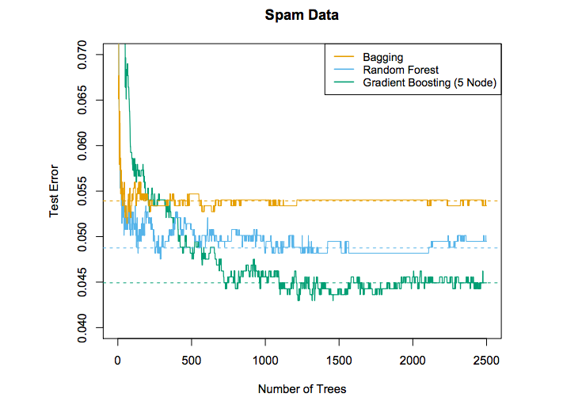

Slide 14
Summary
We briefly discussed bootstrapping
Bagging
Random Forest
Boosting
We learned what elements needed to be tuned in Boosting and Random Forest

